Slide 1

Growth and characterization of GaSb Quantum Rings for Intermediate Band Solar Cells
Work package 3: Materials for energy
D. Montesdeocaª, P. J. Carringtonª, M. C. Wagener^{b}, J. R. Botha^{b}, A. R. J.Marshallª, and A. Krierª
Lancaster University, UK.
Nelson Mandela Metropolitan University, SA.
Cadiz PROMIS Workshop:18-20 May 2016
Notes:
Recently moved to UCL, but the bulk of the work was done whilst I was at Lancaster in collaboration with NMU and TEM done in Warwick.
And I’m going to talk about … specifically GaSb/GaAs QDs for SCs.

Slide 2
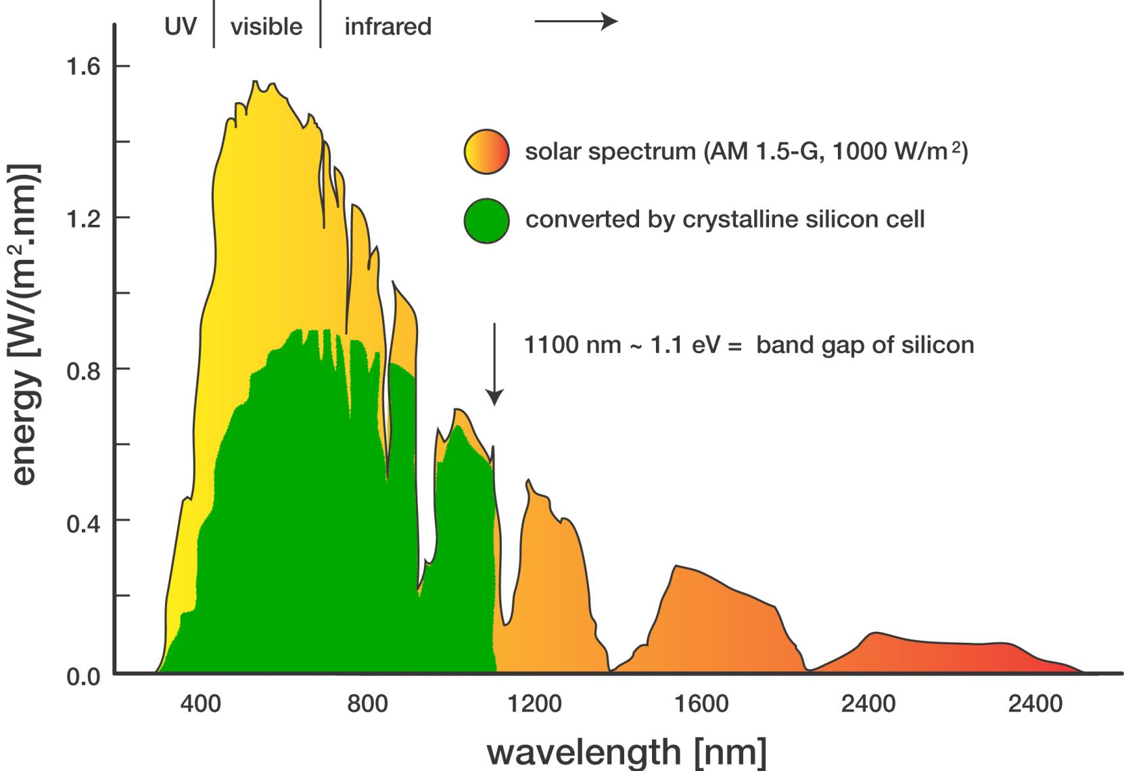
Introduction
Thermalized
Transmission loss
Radiation Absorbed
photon energy > band gap
Radiation Transmitted
photon energy < band gap

Slide 3
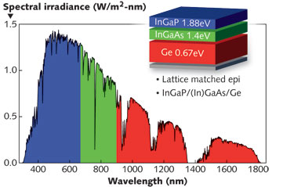
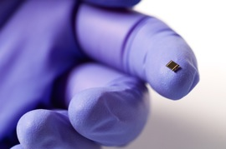
3rd Generation Solar Cells
Multi-junction PV cells
Fraunhofer ISE
η_{record} = 46% (508x) 4-junction cell
Third-generation cells utilise sub-band gap light.
Tandem/stacked cells have produced record efficiencies.
  Expensive and limited to concentrator systems.

Slide 4
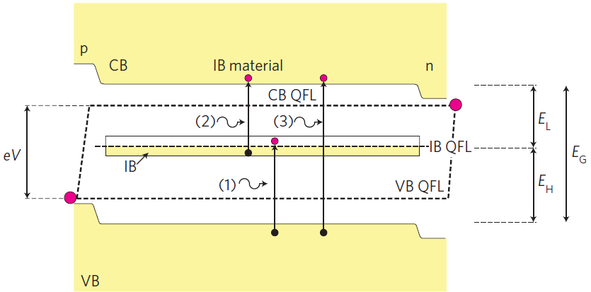
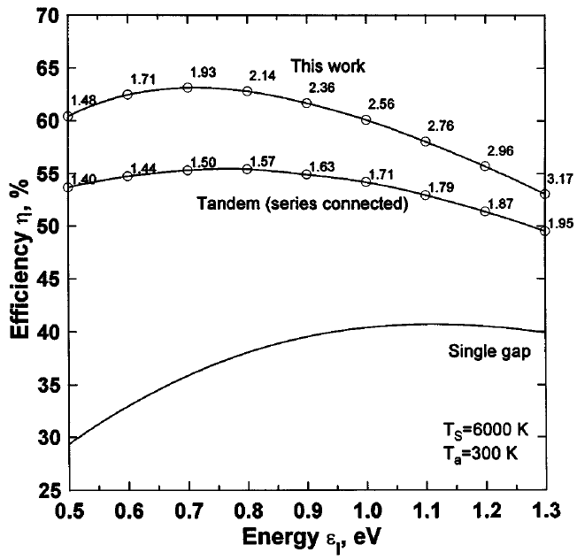
Intermediate Band Solar Cell
The Solar Energy Institute in Madrid
Luque et al., Nature Photonics 6 (2012) 146
Luque and Marti, Phys. Rev. Lett. 78 (1997) 5014
Two operating principles of IBSC:
1) Voc Conservation
2) Two-Photon Subbandgap Photocurrent
3 Fermi levels( E_{F,C} E_{F,V} E_{F,IB})→Partially filling of IB
- No overlapping of absorption
coefficient
- Partially filled IB

Slide 5
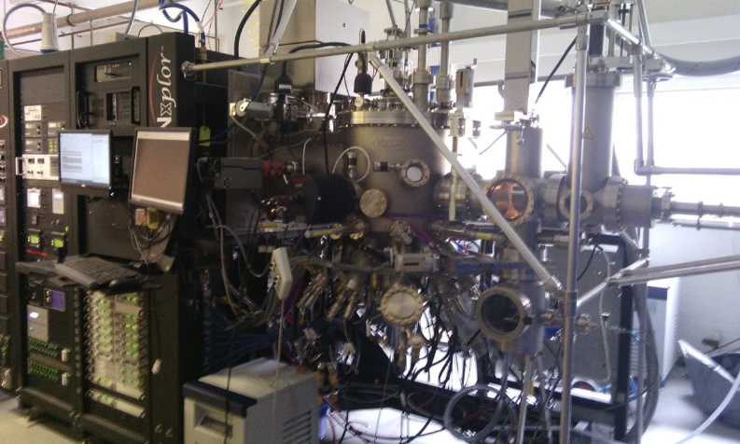
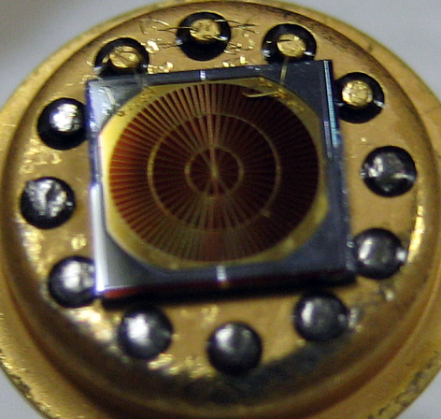
Type II GaSb/GaAs QD/QR Solar Cell
SC Diameter 3.5mm
MBE Veeco GEN xplor
GaAs control cell and 5 and 10 stacks of GaSb/GaAs QD/QR have been grown by Molecular Beam Epitaxy

Slide 6
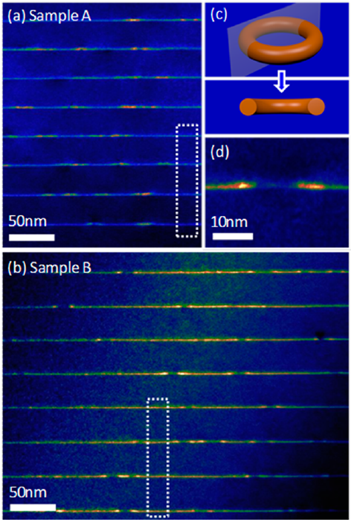
Type II GaSb/GaAs Quantum Rings
dot density ∼ 1 x 10¹⁰ cm⁻²
QD/QR grown by self assembled in MBE (strain between GaAs and GaSb ≈7.8%)
QD/QR density 10¹⁰cm⁻²
QR formation: strain relief (No strain balanced layers required)
Type-II heterostructure ⇒ spatially indirect absorption/recombination

Slide 7
Photo-response and IV under 1-sun
V_{OC} drop
CB
AM 1.5
IB
VB
GaSb quantum rings extends the optical response up to 1400 nm
Short Circuit Current (Jsc) 27.9 mA/cm2→ 5.9% increase
Reduction on Open Circuit Voltage (Voc) ≈400meV

Slide 8
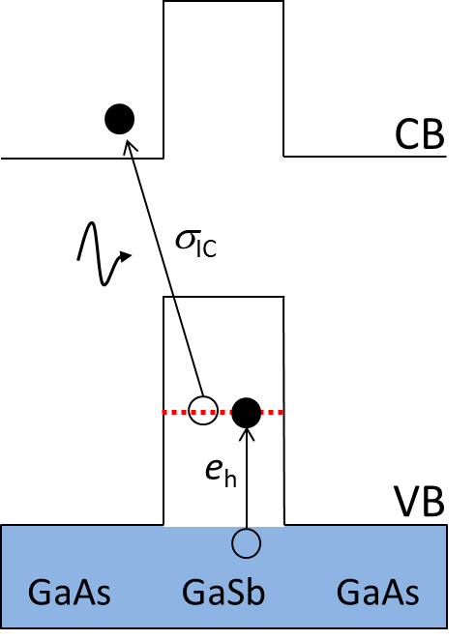
Reason for V_{OC} loss
optical transitions
CB
optical
transitions
IB
IB
thermal
thermal
VB
Decrease in V_{OC} due to thermal emission of holes quantum rings → competing optical and thermal hole-emission
  V_{OC} recovered by cooling or by increasing optical intensity
Need to know/control the optical and thermal emission kinetics
    Absorption coefficient and hole emission rate
H. fujita, J. James, Sem. Sci. Tech., 29 (2014) 035014

Slide 9
Reason for V_{OC} loss
optical transitions
CB
optical
transitions
Competing process
IB
IB
thermal
thermal
VB
Decrease in V_{OC} due to thermal emission of holes quantum rings → competing optical and thermal hole-emission
  V_{OC} recovered by cooling or by increasing optical intensity
Need to know/control the optical and thermal emission kinetics
    Absorption coefficient and hole emission rate
H. fujita, J. James, Sem. Sci. Tech., 29 (2014) 035014

Slide 10
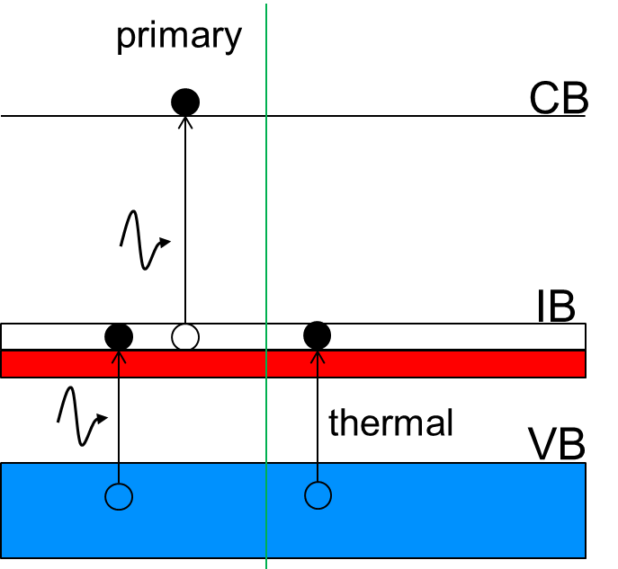
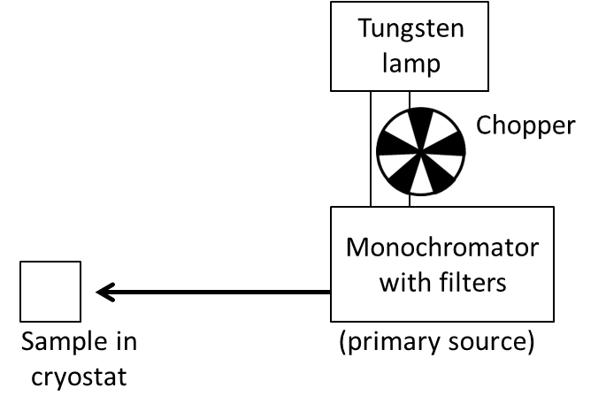
Two-photon response measurement
primary
CB
A
λ
IB
A
A
thermal
VB
Conventional setup of photoresponse spectroscopy.
Sub-bandgap photoresponse limited by hole emission from quantum rings.

Slide 11
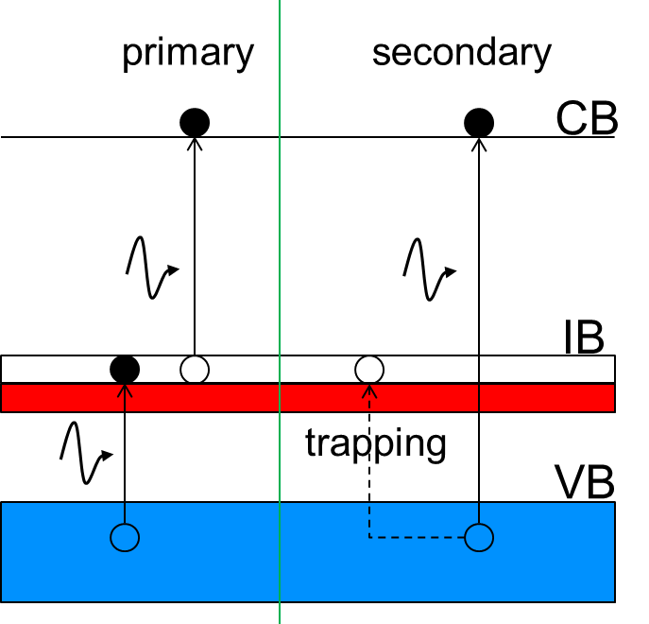
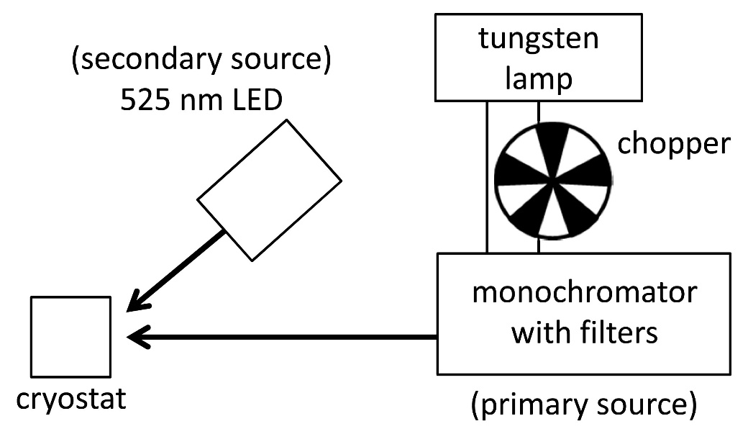
Two-photon response measurement
primary
secondary
CB
A
B
B
λ
IB
A
A
trapping
VB
Charging/photofilling the QR using a second excitation source counteracts hole emission
  Two-step excitation becomes discernable

Slide 12
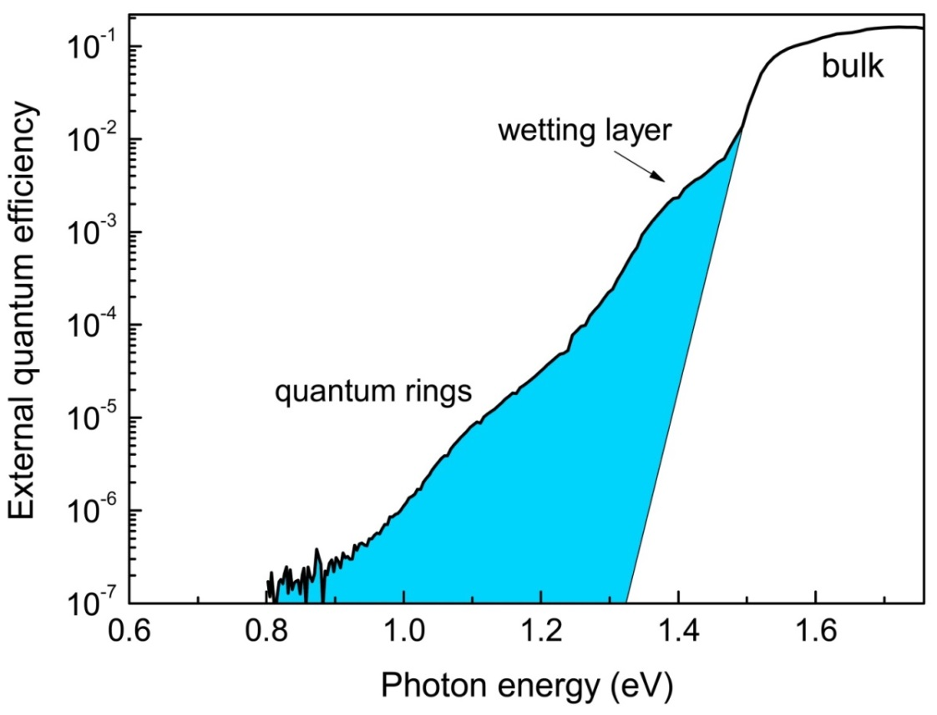
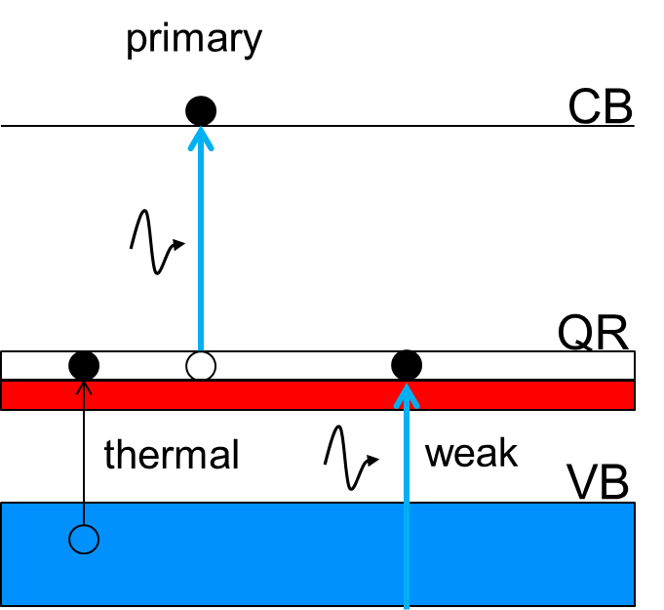
Two-photon response
primary
16 Kelvin
CB
PRIMARY
QR
A
thermal
weak
VB
GaSb quantum rings significantly extends photo-response

Slide 13
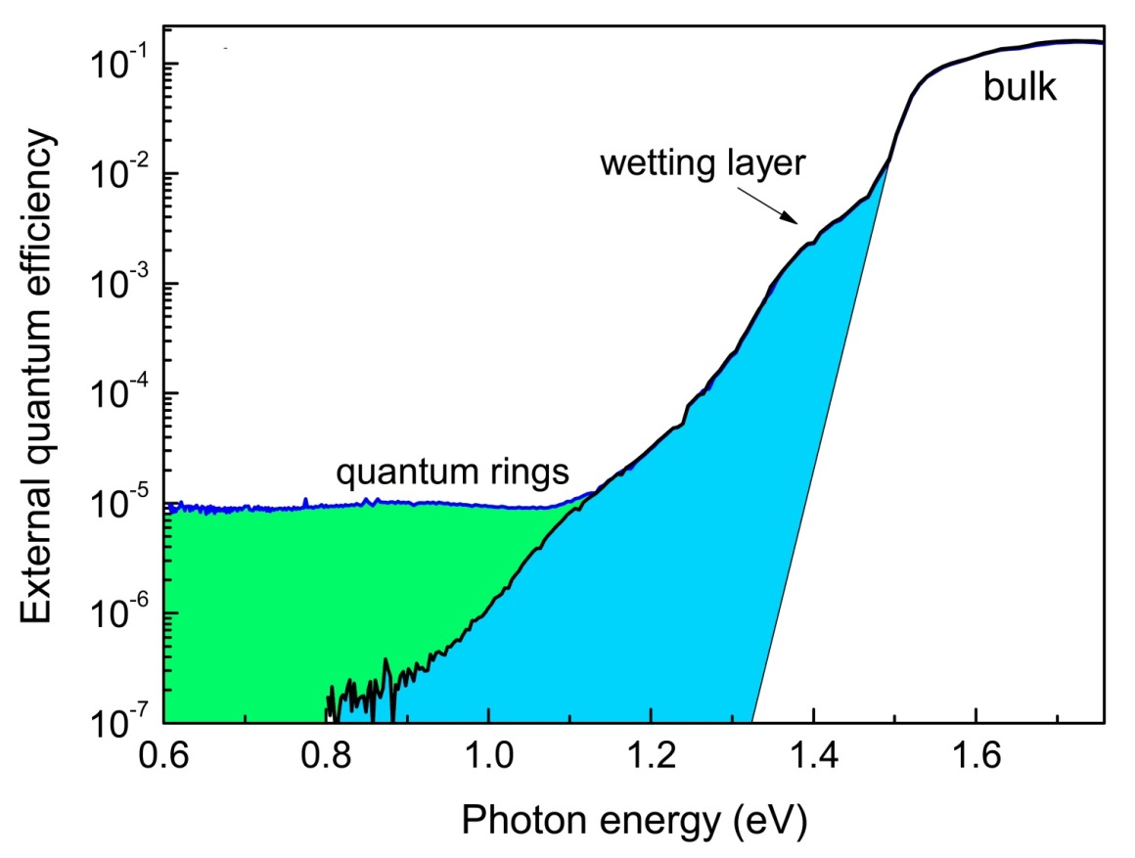
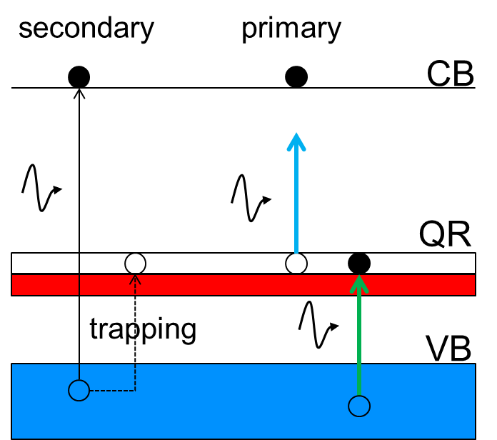
Two-photon response
primary
16 Kelvin
CB
PRIMARY +
PHOTOFILLING
B
A
QR
A
A
+
B
thermal
weak
VB
Second, photofilling source enhances QR response
VERIFIES: 2-photon response via QR states
Wagener et al., Journal of Appl. Phys. 116 (2014) 044304

Slide 14
Summary
Demonstrated quantum dot solar cell through incorporation of GaSb quantum rings in GaAs solar cell.
( 5 and 10 stacks od QD has been fabricated)
Extended cell operation well beyond GaAs response.
Increase in short circuit current about 5.9%.
Successfully demonstrated two-photon absorption using the type-II GaSb/GaAs system at low temperature.

Slide 15
Acknowledgements
Thank you for your attention
Dr. R. Beanland and Dr. Ana Sanchez (TEM) - University of Warwick
Dr Rob Airey and Dr. Ken Kennedy, (Processing) III-V National Centre, Sheffield
EU Marie-Curie photonics training network (PROMIS)

Slide 16
Solving the V_{OC} loss
Open-circuit loss presently the central problem in quantum dot solar cell development
Need to reduce thermal emission from nanostructures
  Move quantum states deeper into band gap
  Increase effective barrier ⇒ avoid wetting layer formation
  ⇒ incorporate barrier layers

